Slide 1

Solar Power Plant design
Lecture-13 : Plant Capacity calculation (off-Gird)

Slide 2
Off Grid Solar power plant (plant Capacity calculation)
SL No | Equipment’s Name | Load (Watt) | Quantity | Operation Hours | Load Schedule |  | Total Watt-Hours
 |  |  |  |  | Day | Night | Day | Night
1 | Tube light | 40 | 10 | 12 | - | 12 | - | 4800
2 | Fan | 40 | 10 | 24 | 12 | 12 | 4800 | 4800
3 | CFL | 16 | 20 | 12 | - | 12 | - | 4800
4 | Geasor | 1500 | 2 | 2 | 2 | - | 6000 | -
5 | Computer | 100 | 10 | 12 | 12 | - | 12000 | -
6 | Outdoor Light | 16 | 20 | 12 | - | 12 | - | 3840
7 | Pump | 746 | 1 | 2 | 2 | - | 1492 | -
 |  |  |  |  |  |  | 24292 | 17280

Slide 3
Total Day consumption = 24292 walt hour = 24.292 KWH
Total Night Time Consumption = 17280 walt hour = 17.280 KWH
Total Consumption = Day time consumption + night time comsumption
=24.292 + 17.280
=41.572 KWH
=42 KWH
*For Night time consumption, we need to consider battery backup.

Slide 4
Calculation of Solar Power plant according to MNRE:
Total Consumption = 42 KWH
Plant peak sunny hour operation 5.6 to 5.8 hours (Normal consideration)
Plant Performance = 70% = 0.7
Solar Power plant capacity = Total consumption
PSH X Plant Performance
= 42000
5.6 x 0.7
= 10714.28 w
= 10.714 KW
= 11 KW (plant capacity to be installed)

Slide 5
1 KW Plant generally gives 3.8 to 4 unit generation
By thumb rule, this plant (11 KW) will give 44 units generation.
or 42 KWH / 4 = 10.5 KW = 11KW
Plant capacity = 11KW
No of PCU = 1 no X 15 KW
Module rating = 250 Wp
Total no of modules required = 15 x 1000
250
= 60No’s

Slide 6
Battery Sizing Calculation:
Battery will be required for night time only.
Hence, Night consumption = 17.280 KWH
Day of Autonomy= 1day (Means how many days it will carry the charge)
Margin is 15% extra i.e (100% + 15%) = 115%=1.15
Battery unit is in AH.

Slide 7
PCU Charge controller Voltage
0.5 KW to 2 KW = 12 V
2 KW to 10 KW = 24 V
10 KW to 20 KW = 48 V
20 KW t0 50 KW = 96 V
50 KW t0 60 KW = 110 V
60 KW to 100 KW = 220 V
Depth of Discharge (DOD) = Assume depth of discharge as 80 % = 0.8
I.e. Battery will not discharge below 20% of battery voltage.
Battery Efficiency = 90 % =0.9

Slide 8
AH = Night time consumption X Design Margin X Day of Autonomy
Charge controller Voltage X Depth of discharge X Battery Efficiency
AH = 17.280 X 1000 X 1 X 1.15
48 X 0.8 X 0.9
= 575 AH
= 600 AH
So, we need 600 AH Battery.
IEC 62548: Solar power plant design norms
Total storage of battery for 1 day = 48V X 600 AH = 288OO KWH = 28.800 KWH
If Battery Voltage is reduced to 24 V. then AH required is - 24V X 1200AH = 28800 KWH

Slide 9
If Battery Voltage is reduced to 24 V, then AH required is = 24V X 1200AH = 28800 KWH
Solar Battery Charger for night consumption required
= 28.800
5.6 X 0.7
= 7.346 KW
Thumb Rule:
For Night consumption, Charge stored in battery (in Load) = 28000 / 4=7.2 KW

Slide 10
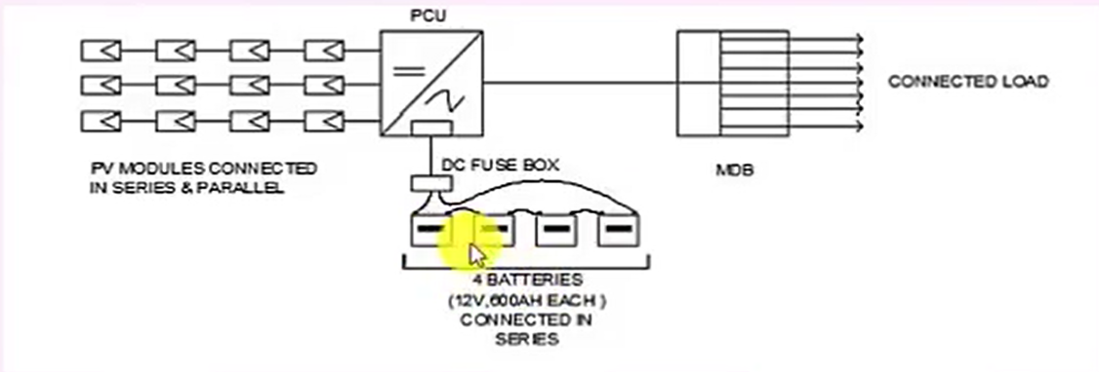
Battery single cell voltage = 2 V
Considered 12V Battery
12 V Battery = 12/2 = 6 cells
No of 12V Battery required in series 4 (i.e. to make 48V)
= 4 no's of battery required

Slide 11
Thank You

